Slide 1
Azure Data Warehouse In-A-Day

Slide 2
Agenda
8:30 AM to 8:45 AM Welcome
8:45 AM to 9:30 AM Introduction to Azure SQL DW
9:30 AM to 10:00 AM New Features and Enhancements
10:00 AM to 10:45 AM Migration Scenarios, Use Cases and Design Patterns
Break: 10:45 AM to 11:00 PM
11:00 AM to 12:00 PM Compete Scenarios and PG Support
Lunch: 12:00 PM to 1:00 PM
1:00 PM to 2:00 PM Lab 1: Data loading scenarios and best practices
2:00 PM to 3:00 PM Lab 2: Performance Tuning best practices
Break: 3:00 PM to 3:15 PM
3:15 PM to 4:00 PM Lab 3: Monitoring, Maintenance and Security
4:00 PM to 4:30 PM Product Roadmap
4:30 to 5:00 PM - Q&A
Notes:
Quickly go through Test Cases to refresh everyone and relate them to agenda topics for the day

Slide 3
Introduction to Azure SQL DW
Tammy Richter Jones
Azure SQL DW CSE
Sr. Program Manager
trichter@microsoft.com

Slide 4
Objectives
Level set our understanding of some key concepts
Physical Architecture*
Data Distribution
Data Indexing
Concurrency*
Notes:
Goals for the Workshop

Slide 5
Changes in Data Warehouse space
Integration with unstructured data
Drive to the cloud
Hardware renewal
Support costs
SQL
Notes:
Data Warehousing has been around now for a while
Migrating this processing to the cloud is being driven by several factors
Although there are many data platform choices you will find in

Slide 6



Azure SQL DW Service
A relational data warehouse-as-a-service, fully managed by Microsoft.
Industries first elastic cloud data warehouse with proven SQL Server capabilities.
Support your smallest to your largest data storage needs.
Elastic scale & performance
Market Leading Price & Performance
Powered by the Cloud
Azure
Azure
Get started in minutes
Integrated with Azure ML, PowerBI, ADB & ADF
Scales beyond petabytes of data
Cloud DW Scale-out Processing
Instant-on compute scales in seconds
Query Relational / Non-Relational
Saas
Simple billing compute & storage
Pay for what you need, when you need it with dynamic pause
Azure
Office 365
Office 365
Public
Cloud
Notes:
Dramatic pause (hahaha)
ADW’s place in the SQL Server landscape
On-premis SQL Server
APS/PDW
IaaS SQL Server
SQL DB
SQL DB Managed Instance
Hyper Scale Options
Elastic Database Options
Azure Data Warehouse

Slide 7
Under the hood - Architecture

Slide 8
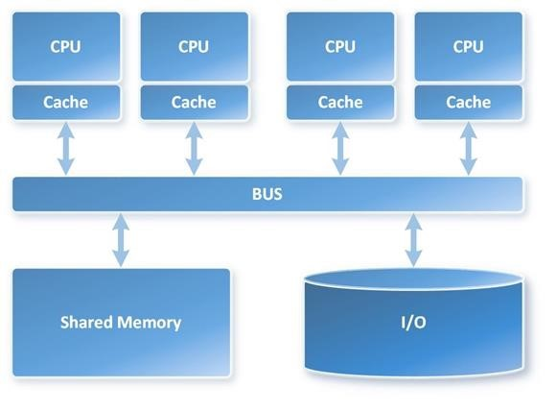
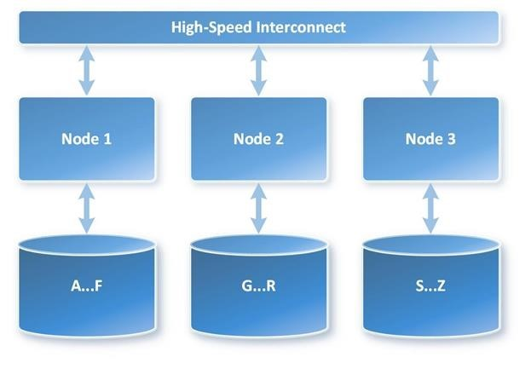
SMP vs. MMP Architecture
VS
Notes:
One Worker with 100 nails and a Hammer → One Worker with 100 nails an a Nail Gun
100 nails divided between 50 workers with a Hammer = 50 workers drive 2 nails each in parallel
100 nails divided between 100 workers with a Hammer = WHACK! Done

Slide 9
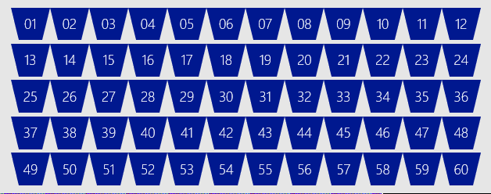
SQL DW Fundamentals
Control
Control
Connection and tool endpoint. Coordinates compute activity.
Engine
DMS
SQL DB
Compute
Handles query processing, ability to scale up/down
Compute
Compute
Compute
Compute
DMS
DMS
DMS
DMS
SQL DB
SQL DB
SQL DB
SQL DB
Dist_DB_1
Dist_DB_2
Dist_DB_15
Dist_DB_16
Dist_DB_17
Dist_DB_30
Dist_DB_31
Dist_DB_32
Dist_DB_45
Dist_DB_46
Dist_DB_47
Dist_DB_60
DMS: Data Movement Services
Coordinates data movement between nodes
…
…
…
…
Storage
Remote storage. Scales independently of compute
Blob Storage
Notes:
Compute Node VM hosting two key components of SQL DW.
These two key SQL DB and DMS.
DMS, stands for Data Movement Service
cover more later on why move data
SQL DB crunching the data and DMS moving
Third component to SQL DW, the Engine.
primary function is to optimize and manage incoming work.
Engine parses and creates query plans.
Compute node has several SQL databases.
MPP
Data is distributed into 60 distributions on storage
Each compute node is associated with a set of distributions
1 Node would have all 60 distributions
60 nodes would have 1 distribution each
This example is DW500, each compute node is hosting 12 databases.
Let’s say we want to take this DW500 and scale it up to a DW1000
What happens behind the scenes?
(1) take all of the SQL Databases down, (2) add 5 more compute nodes
(3) start up the SQL DB databases again.
some of the databases are on different compute nodes
6 distributions per node rather than 12
Each Node has half the work now

Slide 10
Data Warehouse Units
DWUc
100
200
300
400
500
600
1000
1200
1500
2000
3000
6000
…
30000
Normalized amount of compute
Converts to billing units i.e. what you pay
CPU
RAM
I/O
Notes:
Need to modify for Gen2

Slide 11


Separate compute from storage
SQL
Control
Compute
Premium Storage
Notes:
De-coupled storage from compute & control
Completely elastic
Pay for the data you store and the compute you provision

Slide 12
Independently scale compute
SQL
Control
Compute
Premium Storage
Notes:
De-coupled storage from compute & control
Completely elastic
Pay for the data you store and the compute you provision

Slide 13
Pause and resume workload
SQL
Control
Compute
Premium Storage
Notes:
De-coupled storage from compute & control
Completely elastic
Pay for the data you store and the compute you provision

Slide 14


Management Interfaces
 | Portal | PowerShell | T-SQL
Create
Pause and resume
Scale

Slide 15
Scaling via T-SQL and PowerShell
T-SQL
ALTER DATABASE ContosoRetailDW
MODIFY (service_objective = 'DW100');
PowerShell
Set-AzureRmSqlDatabase `
–ResourceGroupName "RG_name" `
–ServerName "SRV_name" `
–DatabaseName "DB_name" `
-RequestedServiceObjectiveName "DW1000"

Slide 16
Query Execution
Result
Query
SQL
Control
Compute
Premium Storage

Slide 17
Data Distribution

Slide 18
Table Distribution Options
Hash Distributed
Round Robin
(Default)
Replicated
Data divided across nodes based on hashing algorithm
Same value will always hash to same distribution
Single column only
Data distributed evenly across nodes
Easy place to start, don’t need to know anything about the data
Simplicity at a cost
Data repeated on every node
Simplifies many query plans and reduces data movement
Best with joining hash table
Check for Data Skew, NULLS, -1
Will incur more data movement at query time
Consumes more space
Joining two Replicated Table runs
on one node

Slide 19
Creating tables
CREATE TABLE [build].[FactOnlineSales]
(
[OnlineSalesKey] int NOT NULL
, [DateKey] datetime NOT NULL
, [StoreKey] int NOT NULL
, [ProductKey] int NOT NULL
, [PromotionKey] int NOT NULL
, [CurrencyKey] int NOT NULL
, [CustomerKey] int NOT NULL
, [SalesOrderNumber] nvarchar(20) NOT NULL
, [SalesOrderLineNumber] int NULL
, [SalesQuantity] int NOT NULL
, [SalesAmount] money NOT NULL
)
WITH
( CLUSTERED COLUMNSTORE INDEX
, DISTRIBUTION = ROUND_ROBIN
)
;
CREATE TABLE [build].[FactOnlineSales]
(
[OnlineSalesKey] int NOT NULL
, [DateKey] datetime NOT NULL
, [StoreKey] int NOT NULL
, [ProductKey] int NOT NULL
, [PromotionKey] int NOT NULL
, [CurrencyKey] int NOT NULL
, [CustomerKey] int NOT NULL
, [SalesOrderNumber] nvarchar(20) NOT NULL
, [SalesOrderLineNumber] int NULL
, [SalesQuantity] int NOT NULL
, [SalesAmount] money NOT NULL
)
WITH
( CLUSTERED COLUMNSTORE INDEX
, DISTRIBUTION = HASH([ProductKey])
)
;

Slide 20
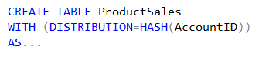
Hash Distributed
Dist_1
ProductSales – Raw Data
Dist_2
AccountID | SalesAmt | …
47 | $1,234.36 | …
36 | $2,345.47 | …
14 | $3,456.58 | …
25 | $4,567.69 | …
48 | $5,678.70 | …
37 | $6,789.81 | …
… | … | …
47 | $1,234.36 | …
Dist_3
36 | $2,345.47 | …
Hash(47)
Hash(36)
14 | $3,456.58 | …
Dist_4
25 | $4,567.69 | …
48 | $5,678.70 | …
37 | $6,789.81 | …
Dist_5
…
Dist_N

Slide 21
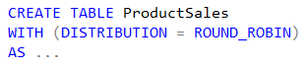
Round Robin Distributed
Dist_1
ProductSales – Raw Data
Dist_2
AccountID | SalesAmt | …
47 | $1,234.36 | …
36 | $2,345.47 | …
14 | $3,456.58 | …
25 | $4,567.69 | …
48 | $5,678.70 | …
37 | $6,789.81 | …
42 | $1,632.25 | …
88 | $4,453.21 | …
52 | $7,892.81 | ...
91 | $9,549.64 | …
66 | $2,498.14 | …
23 | $3,145.99 | …
47 | $1,234.36 | …
Dist_3
36 | $2,345.47 | …
14 | $3,456.58 | …
Dist_4
25 | $4,567.69 | …
48 | $5,678.70 | …
37 | $6,789.81 | …
Dist_5
42 | $1,632.25 | …
…
88 | $4,453.21 | …
Dist_N
52 | $7,892.81 | …
91 | $9,549.64 | …
66 | $2,498.14 | …
23 | $3,145.99 | …
Notes:
Default

Slide 22
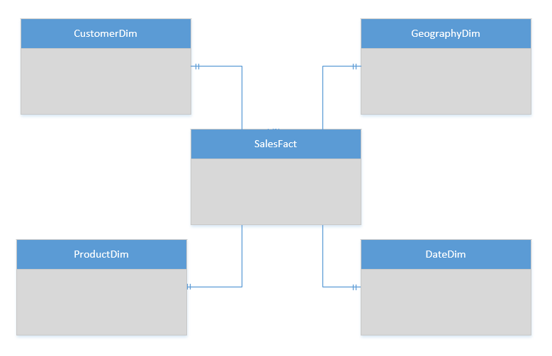
Replicated Table Scenarios
Scenarios to consider using Replicated tables:
Star schema reporting
Dimensions – descriptive entities about fact data
ETL master data, common domain data used during transaction loading

Slide 23
T-SQL: Create a Replicated table
CREATE TABLE dbo.DimCustomer
( CustomerKey int NOT NULL
, GeographyKey int NULL
, CustomerAlternateKey nvarchar(15) NOT NULL
, Title nvarchar(8) NULL
, FirstName nvarchar(50) NULL
, LastName nvarchar(50) NULL
, BirthDate date NULL
, Gender nvarchar(1) NULL
, EmailAddress nvarchar(50) NULL
, YearlyIncome money NULL
, DateFirstPurchase date NULL
)
WITH
( CLUSTERED COLUMNSTORE INDEX
, DISTRIBUTION = REPLICATED
)

Slide 24

Replicated Tables… How it works
Compute Node 1
RR Table
RR Table
RR Table
RR Table
Cache Build Request
Replication Cache Manager
Repl Table
Distribution_1
Distribution_2
Distribution_3
Distribution_4
Compute Node 2
CREATE
CREATE
SELECT
SELECT
UPDATE
UPDATE
RR Table
RR Table
RR Table
RR Table
Repl Table
Distribution_5
Distribution_6
Distribution_7
Distribution_8
Notes:
WHY A CACHE? – TO ACHIEVE ELASTICITY
With GA, the replicated table cache is no longer built as a step in the query plan during the runtime of the query. A select against a replicated table without a cache built submits a request to build the cache to the replication cache manager, asynchronously and is resolved immediately against the round robin table. The cache manager has a simple queueing mechanism and immediately builds the cache.

Slide 25
Why data moves
Data has to be co-located to operated on…
Common reasons:
Incompatible join
Incompatible aggregation

Slide 26
Data Movement Types for a Query
DMS Operation | Description
ShuffleMoveOperation | Distribution → Hash algorithm → New distribution Changing the distribution column in preparation for join.
PartitionMoveOperation | Distribution → Control Node Aggregations - count(*) is count on nodes, sum of count
BroadcastMoveOperation | Distribution → Copy to all distributions Changes distributed table to replicated table for join.
TrimMoveOperation | Replicated table → Hash algorithm → Distribution When a replicated table needs to become distributed. Needed for outer joins.
MoveOperation | Control Node → Copy to all distributions Data moved from Control Node back to Compute Nodes resulting in a replicated table for further processing.

Slide 27
Joining HASH tables
Store_Sales HASH([ProductKey])
[ProductKey] INT NULL
Web_Sales HASH([ProductKey])
[ProductKey] INT NULL

Slide 28
Joining HASH tables
Store_Sales HASH([ProductKey])
[ProductKey] INT NULL
Web_Sales HASH([ProductKey])
[ProductKey] BIGINT NULL

Slide 29
Aggregation - compatible
Resolved completely on each compute node
No Data Movement
Hash Distribution Key is contained in the group by keys
Count Distinct on distribution key
-- FactOnlineSales distributed on ProductKey
SELECT COUNT_BIG(*)
FROM [cso].[FactOnlineSales]
GROUP BY [ProductKey]
SELECT COUNT_BIG(DISTINCT ([ProductKey]))
FROM [cso].[FactOnlineSales]

Slide 30
Aggregation - Incompatible
Partially aggregated on each node
Shuffle move co-locates rows with same group by key
Table is round robin distributed
Hash Distribution key is not contained in group by keys
Count Distinct on non-distribution key or on round robin table
-- FactOnlineSales distributed on ProductKey
SELECT COUNT_BIG(*)
FROM [cso].[FactOnlineSales]
GROUP BY [StoreKey]
SELECT COUNT_BIG(DISTINCT [DateKey])
FROM [cso].[FactOnlineSales]

Slide 31
Distribution Guidance
For large fact tables, best option is to Hash Distribute
Clustered Columnstore
Distribute on column that is joined to other fact tables or large dimensions
Primary or surrogate key maybe a good choice for distribution
However, be mindful of …
Hash column should have highly distinct values (Minimum 600 distinct values)
Avoid distributing on a date column
Avoid distributing on column with high frequency of NULLs and default values (e.g. -1)
Distribution column is NOT updatable
For compatible joins use the same data types for two distributed tables
If there are no distribution columns that make sense, then use Round Robin as last resort

Slide 32
Skewed Distribution

Slide 33
Finding Skew
DBCC PDW_SHOWSPACEUSED
Not a programmatic interface
DMV gives more detail and control
sys.dm_pdw_nodes_db_partition_stats
Refer to the view dbo.vTableSizes provided in docs (Table Size Queries)
select distribution_id,SUM(row_count) as total_distribution_row_count
from dbo.vTableSizes
where schema_name = ‘Fact’ and table_name = ‘Flights’
group by distribution_id
order by total_distribution_row_count;

Slide 34
Indexing

Slide 35
Indexing Choices
Row Store : Clustered Index
Column Store : Clustered Columnstore Index
Heap : No index
Non-Clustered Index
Notes:
https://docs.microsoft.com/en-us/azure/sql-data-warehouse/sql-data-warehouse-tables-index
CCI = default
HEAP is a keyword

Slide 36
Creating tables
CREATE TABLE [dbo].[DimStore]
(
[StoreKey] int NOT NULL
, [GeographyKey] int NOT NULL
, [StoreName] nvarchar(100) NOT NULL
, [StoreType] nvarchar(15) NULL
, [StoreDescription] nvarchar(300) NOT NULL
, [Status] nvarchar(20) NOT NULL
, [OpenDate] datetime NOT NULL
, [CloseDate] datetime NULL
, [ETLLoadID] int NULL
, [LoadDate] datetime NULL
, [UpdateDate] datetime NULL
)
WITH
( CLUSTERED INDEX([StoreKey])
, DISTRIBUTION = ROUND_ROBIN
)
;
CREATE TABLE [dbo].[FactOnlineSales]
(
[OnlineSalesKey] int NOT NULL
, [DateKey] datetime NOT NULL
, [StoreKey] int NOT NULL
, [ProductKey] int NOT NULL
, [PromotionKey] int NOT NULL
, [CurrencyKey] int NOT NULL
, [CustomerKey] int NOT NULL
, [SalesOrderNumber] nvarchar(20) NOT NULL
, [SalesOrderLineNumber] int NULL
, [SalesQuantity] int NOT NULL
, [SalesAmount] money NOT NULL
)
WITH
( CLUSTERED COLUMNSTORE INDEX
, DISTRIBUTION = HASH([ProductKey])
)
;
Row
Column
Distribution
Notes:
When to use a
Clustered Index – smaller tables like dimensions when joins are done to single rows by key
CCI – those big tables
HEAP – when tables are small and for staging tables

Slide 37
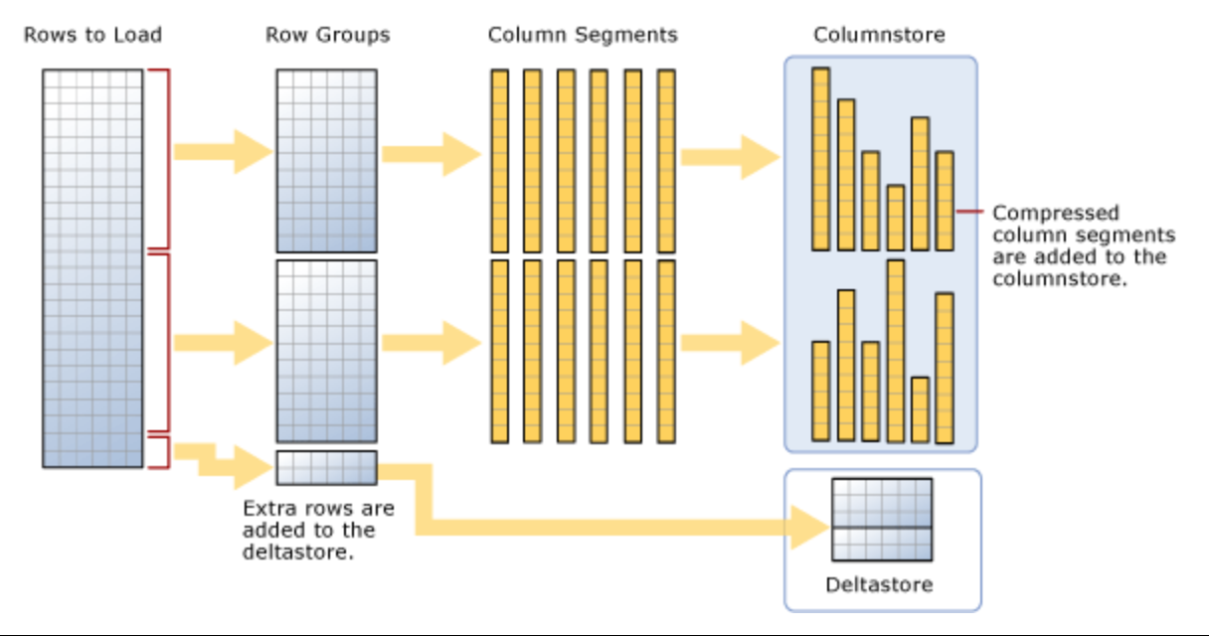
Clustered Columnstore Index
Notes:
https://docs.microsoft.com/en-us/sql/relational-databases/indexes/columnstore-indexes-described?view=sql-server-2014
A rowgroup usually contains the maximum number of rows per rowgroup which is 1,048,576 rows.
Each rowgroup contains one column segment for every column in the table.
Each column segment is compressed together and stored on physical media.

Slide 38
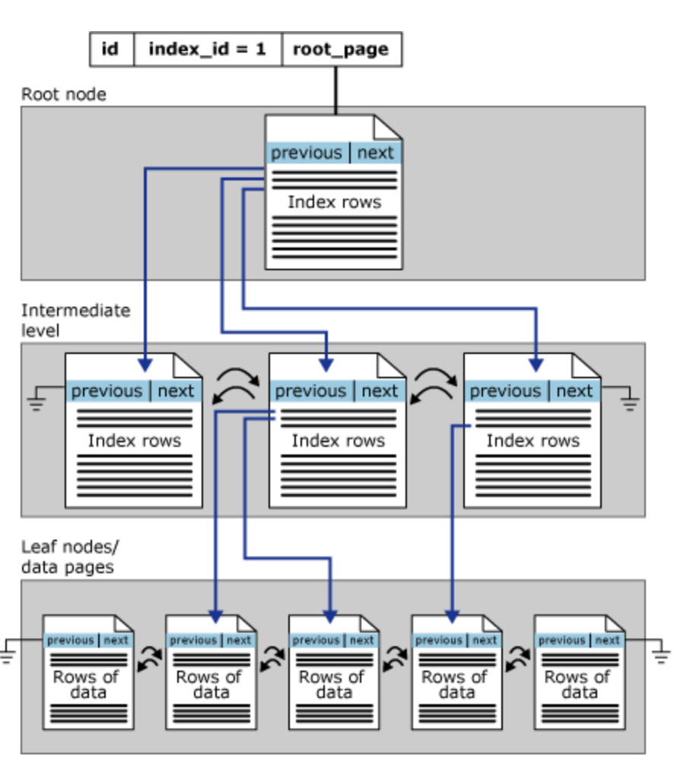
Clustered Index (Row Store)
Notes:
Clustered Index on a single partition
https://docs.microsoft.com/en-us/sql/relational-databases/sql-server-index-design-guide?view=sql-server-2017

Slide 39
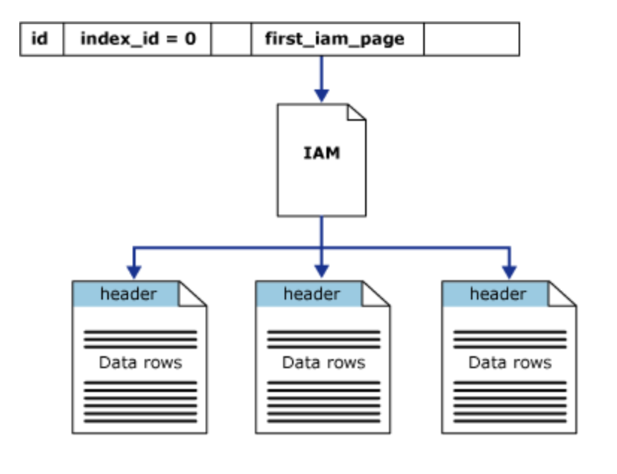
Heap (No Index)
Notes:
Heap on a single partition

Slide 40
Scale out = Distributed tables
ROW STORE
COLUMN STORE
Notes:
Illustrates the compression that you get with CCI

Slide 41
Clustered Columnstore & Partitioning
CREATE TABLE [dbo].[FactInternetSales]
(
[ProductKey] int NOT NULL ,
[OrderDateKey] int NOT NULL ,
[CustomerKey] int NOT NULL ,
[PromotionKey] int NOT NULL ,
[SalesOrderNumber] nvarchar(20) NOT NULL ,
[OrderQuantity] smallint NOT NULL ,
[UnitPrice] money NOT NULL ,
[SalesAmount] money NOT NULL
)
WITH ( CLUSTERED COLUMNSTORE INDEX ,
DISTRIBUTION = HASH([ProductKey]) ,
PARTITION ( [OrderDateKey] RANGE RIGHT FOR
VALUES (20000101,20010101,20020101,20030101,20040101,20050101)
)
)
;
Notes:
https://docs.microsoft.com/en-us/azure/sql-data-warehouse/sql-data-warehouse-tables-partition
Loading benefits
Query benefits
Careful do not over partition
need 1000000 rows per CCI segment
each distribution is partitioned (60)
For optimal compression and performance of clustered columnstore tables, a minimum of 1 million rows per distribution and partition is needed. Before partitions are created, SQL Data Warehouse already divides each table into 60 distributed databases. Any partitioning added to a table is in addition to the distributions created behind the scenes.

Slide 42
Polybase

Slide 43
WHAT does PolyBase do?
Load Data
Use external tables as an ETL tool to cleanse data before loading
Age-out Data
Age data to HDFS or Azure Storage as ‘cold’ but query-able.
Interactively Query
Analyze relational and non-relational data together
HOW does it do it?
Imposes structure on semi-structured data
Define external tables over data
Reads/Writes Hadoop file formats
Text, CSV, RCFILE, ORC, Parquet, Avro, etc.
Parallelizes Data Transfers
Direct loads to service compute nodes

Slide 44
Concurrency, Concurrency Slots and Resource Classes

Slide 45
Concurrent queries
QID
QID
128
active queries
1024
open sessions
QID
QID
QID
QID
Notes:
https://docs.microsoft.com/en-us/azure/sql-data-warehouse/sql-data-warehouse-concept-recommendations

Slide 46





Importance of concurrency
Parallel queries = more throughput (even on large, scale-out DWs)
Mixed workloads (transform, load, export, query)
A single query is not guaranteed to consume all resources

Slide 47
Concurrency slots
Concurrency Slots
20 per DW500c: 250MB/slot
4 per DW100: 100MB/slot
Total system
available memory

Slide 48
Concurrent Query and Slots
Notes:
Query cap = number of running queries
Slots = size of queries that are running
Concurrency slots are NOT changing with the increase to concurrency.

Slide 49
Resource classes
Dynamic
Increases resource consumption as you scale
No increase in concurrency as you scale
Static
Maintain resource consumption as you scale
Increase concurrent queries as you scale
Consume Slots
Increase memory
Isolate resources
Notes:
Key point:
-Dynamic: as you scale, queries have more slots and ram to run faster, not more of those queries.
-Static: as you scale, queries have the same amount of slots and ram, you can run more of them.

Slide 50

Resource Classes – Dynamic
Allocates variable amounts of memory depending on the scale of the DW instance.
Beneficial for variable sized workloads that scale to meet demand.
There is no increase in concurrency with scaling.
Scaling up

Slide 51
Dynamic Resource Class Example at DW3000c
System | Concurrency Slots
Concurrency Slots | 120
Query Memory, GB | 1,800
Resource Class | Concurrency Slots | Query Memory, GB | Concurrency
SmallRc | 3 | 45 | 32
MediumRc | 12 | 180 | 10
LargeRc | 26 | 390 | 4
XLargeRc | 84 | 1,260 | 1

Slide 52
Dynamic Resource Class Example at DW6000c
System | Concurrency Slots
Concurrency Slots | 240
Query Memory, GB | 3,600
Resource Class | Concurrency Slots | Query Memory, GB | Concurrency
SmallRc | 7 | 105 | 32
MediumRc | 24 | 360 | 10
LargeRc | 52 | 780 | 4
XLargeRc | 168 | 2,520 | 1

Slide 53
Resource Classes – Static
Allocates a fixed amount of memory regardless of the scale level.
Essential for high query concurrency workloads.
Queries may run the same regardless of the service level.
Scaling up

Slide 54
Static Resource Class Example at DW3000c
System | Concurrency Slots
Concurrency Slots | 120
Query Memory, GB | 1,800
Resource Class | Concurrency Slots | Query Memory, GB | Concurrency
StaticRc10 | 1 | 15 | 64
StaticRc20 | 2 | 30 | 60
StaticRc30 | 4 | 60 | 30
StaticRc40 | 8 | 120 | 15
StaticRc50 | 16 | 240 | 7
StaticRc60 | 32 | 480 | 3
StaticRc70 | 64 | 960 | 1
StaticRc80 | 64 (128 if available) | 960 | 1

Slide 55
Static Resource Class Example at DW6000c
System | Concurrency Slots
Concurrency Slots | 240
Query Memory, GB | 3,600
Resource Class | Concurrency Slots | Query Memory, GB | Concurrency
StaticRc10 | 1 | 15 | 128
StaticRc20 | 2 | 30 | 120
StaticRc30 | 4 | 60 | 80
StaticRc40 | 8 | 120 | 30
StaticRc50 | 16 | 240 | 15
StaticRc60 | 32 | 480 | 7
StaticRc70 | 64 | 960 | 3
StaticRc80 | 128 | 1,920 | 1

Slide 56
Bringing it all together
At DW6000c
staticrc20 - 2
staticrc10 - 1
smallrc - 7

Slide 57
Monitoring

Slide 58
Monitoring Options
Azure Portal
Common interface
Alerts
Recommendations
Retention periods
Operations Management Suite (OMS) integration
Command-line
Rich set of DMVs
Lower level of diagnostics

Slide 59
Azure Portal
Key Metrics
CPU Percentage
IO Percentage
DWU (limit, used and percentage used)
Connections (successful, failed, blocked by firewall)
Gen2: Cache metrics (used and cache hit percentage)

Slide 60
Execution DMVs
Sessions
Data Movement Steps (DMS)
dm_pdw_exec_sessions
session_id (PK)
dm_pdw_dms_workers
request_id (PK)
step_index (PK)
Queries
dm_pdw_exec_requests
request_id (PK)
session_id
SQL Queries (On Operations)
Waits
Query Plan Steps
dm_pdw_sql_requests
request_id (PK)
step_index (PK)
dm_pdw_waits
request_id (PK)
object_name (PK)
dm_pdw_request_steps
request_id (PK)
step_index (PK)

Slide 61
Additional Resources
Azure site: http://aka.ms/sqldw
SQL DW suggestions: http://aka.ms/sql-dw-feedback
Stack Overflow – Tag: azure-sqldw
Twitter: @AzureSQLDW

Slide 62
Q&A

Slide 63
Appendix

Slide 64
Data Protection

Slide 65
Backup Options
Automatic Restore Points
Snapshots taken automatically by the system.
Every few hours for an 8 hour RPO
Maintained for 7 days.
On by default, cannot be disabled.
User-Defined Restore Points
NEW!
Manually triggered
Good for snapshots before large data modifications
Can also be used to restore reporting offload instance.
Can maintain & update 42 restore points.

Slide 66
Geo-redundancy
Notes:
Platform as a Service (PaaS)
Leverages the cloud
Database snapshots are taken on a regular basis to support a global 8 hour RPO
A geo redundant snapshot can be used to bring online the database in any region
1 backup a day made available
Standard RA-GRS rates (per GB)
Charged for full size of the backup

